Slide 1
Ad Valorem Revenue and School Quality: Predicting School Performance in Oklahoma Public Schools Using Neural Networks, PCA and Regression
Tom Curran
MACSS Project Proposal
April 4, 2018

Slide 2
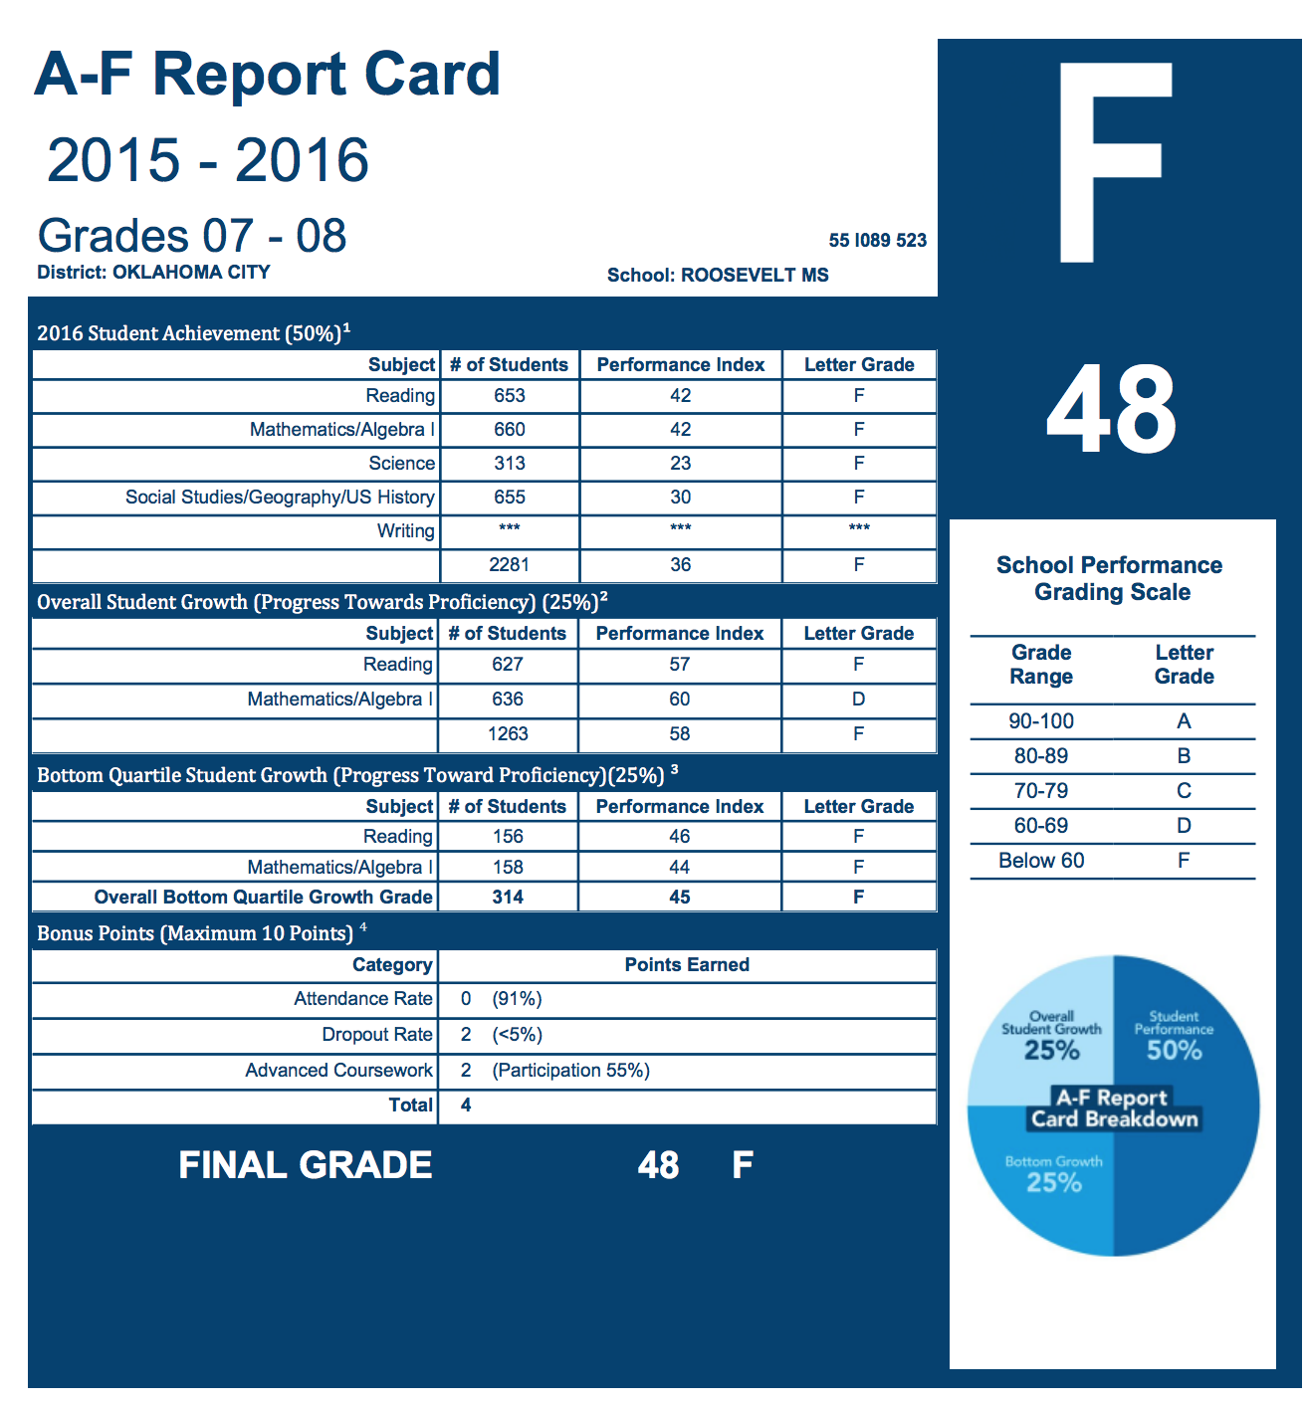
Research Question:
Is a school district’s ad valorem revenue the primary driver of school quality in Oklahoma?
Oklahoma school quality is measured in through a statewide evaluation tool called the A – F Report card
Schools are issued a letter grade at the end of each academic year to judge their academic performance on end of year state subject tests
A-F Letter grade is based entirely on test performance and does not account for socio-economic factors

Slide 3
research supports conventional wisdom
More money means more and better teachers:
“Students of less effective teachers experienced reading achievement gains of one third of a standard deviation less than that of students with effective teachers. In mathematics the differences was slightly less than one half a standard deviation.” (Stronge et al 2008)
More money means smaller class sizes, even when quality teachers are not available
Class Size Reduction and Student Achievement: The Potential Tradeoff between Teacher Quality and Class Size (Jepsen et al 2007)

Slide 4
Research also disproves conventional wisdom:
School quality and outcomes of students is not related to student teacher ratio or spending:
“…studies find that, on balance, improving school resources such as the pupil-teacher ratio or per pupil spending do not improve students performance on standardized achievement tests” (Eide et al 1997)
The Effects of Class Size on Student Achievement: New Evidence from Population Variation (Hoxby 2008)
A students performance is not related to school quality but more reliant on parents and family:
“Most previous research on effects of school has concluded that the effect of school or teacher quality on academic achievement is less than that of family background or other characteristics” (Heyneman et al 1983)
School quality doesn’t matter at all:
Does School Quality Matter? Evidence From The National Longitudinal Survey of Youth (Betts 1995)

Slide 5
Goals & Contribution of Research:
Goals:
Understand how different economic and sociological factors interact with each other to influence school quality
Create predictive model for school quality using Oklahoma’s existing A-F Framework
Employ model to create and enhance existing policy levers
Research Contribution:
Very little school quality program evaluation literature employs neural networks
Using neural networks and other theoretical approaches means model is not constrained to a subject domain
Captures the complex interactions of variables that eludes other predictive or explanatory models
Brings together diverse but related data sets to develop a more robust models

Slide 6
Why this project is interesting
Oklahoma is ranked #39 in education
What's the Matter with Oklahoma – Economist Article from January 30th 2018
Budget Crisis forces 4 day school week
As of April 2, 2018 Teachers in Oklahoma are on strike – similar to West Virginia
Ad Valorem Taxes make up a large percentage of school district’s revenue
Lots of economic activity in Oklahoma
Scott Pruitt, former AG of Oklahoma, opened Oklahoma to fracking for oil and gas causing a surge in revenues for Oklahoma counties and added land valuation
Google building server farms in Oklahoma (Minco County)

Slide 7
Data and Sources
Oklahoma has a robust reporting index that offers rich variety of data source:
Office of Educational Quality and Accountability District and School Profile Reports
Reports will provide basis for non financial dimensions to analysis
Included Data:
ADM, ADA, % Attending College, Average ACT Score, Suspension Rates, Average Income, Average Property Value, % of parents attending Parent Teacher Conference, juvenile arrests, Free and Reduced Lunch
Oklahoma Cost Accounting System District Revenue Summary Reports:
Detailed break down of state and federal incomes for school budgets
Will act as the main source of calculating ad valorem revenue as well as any other revenue source
Data available from 2006 to 2017
Oklahoma A-F Reporting Index:
Contains A-F Index Scores and inputs into A-F Score for 2013 - 2016

Slide 8
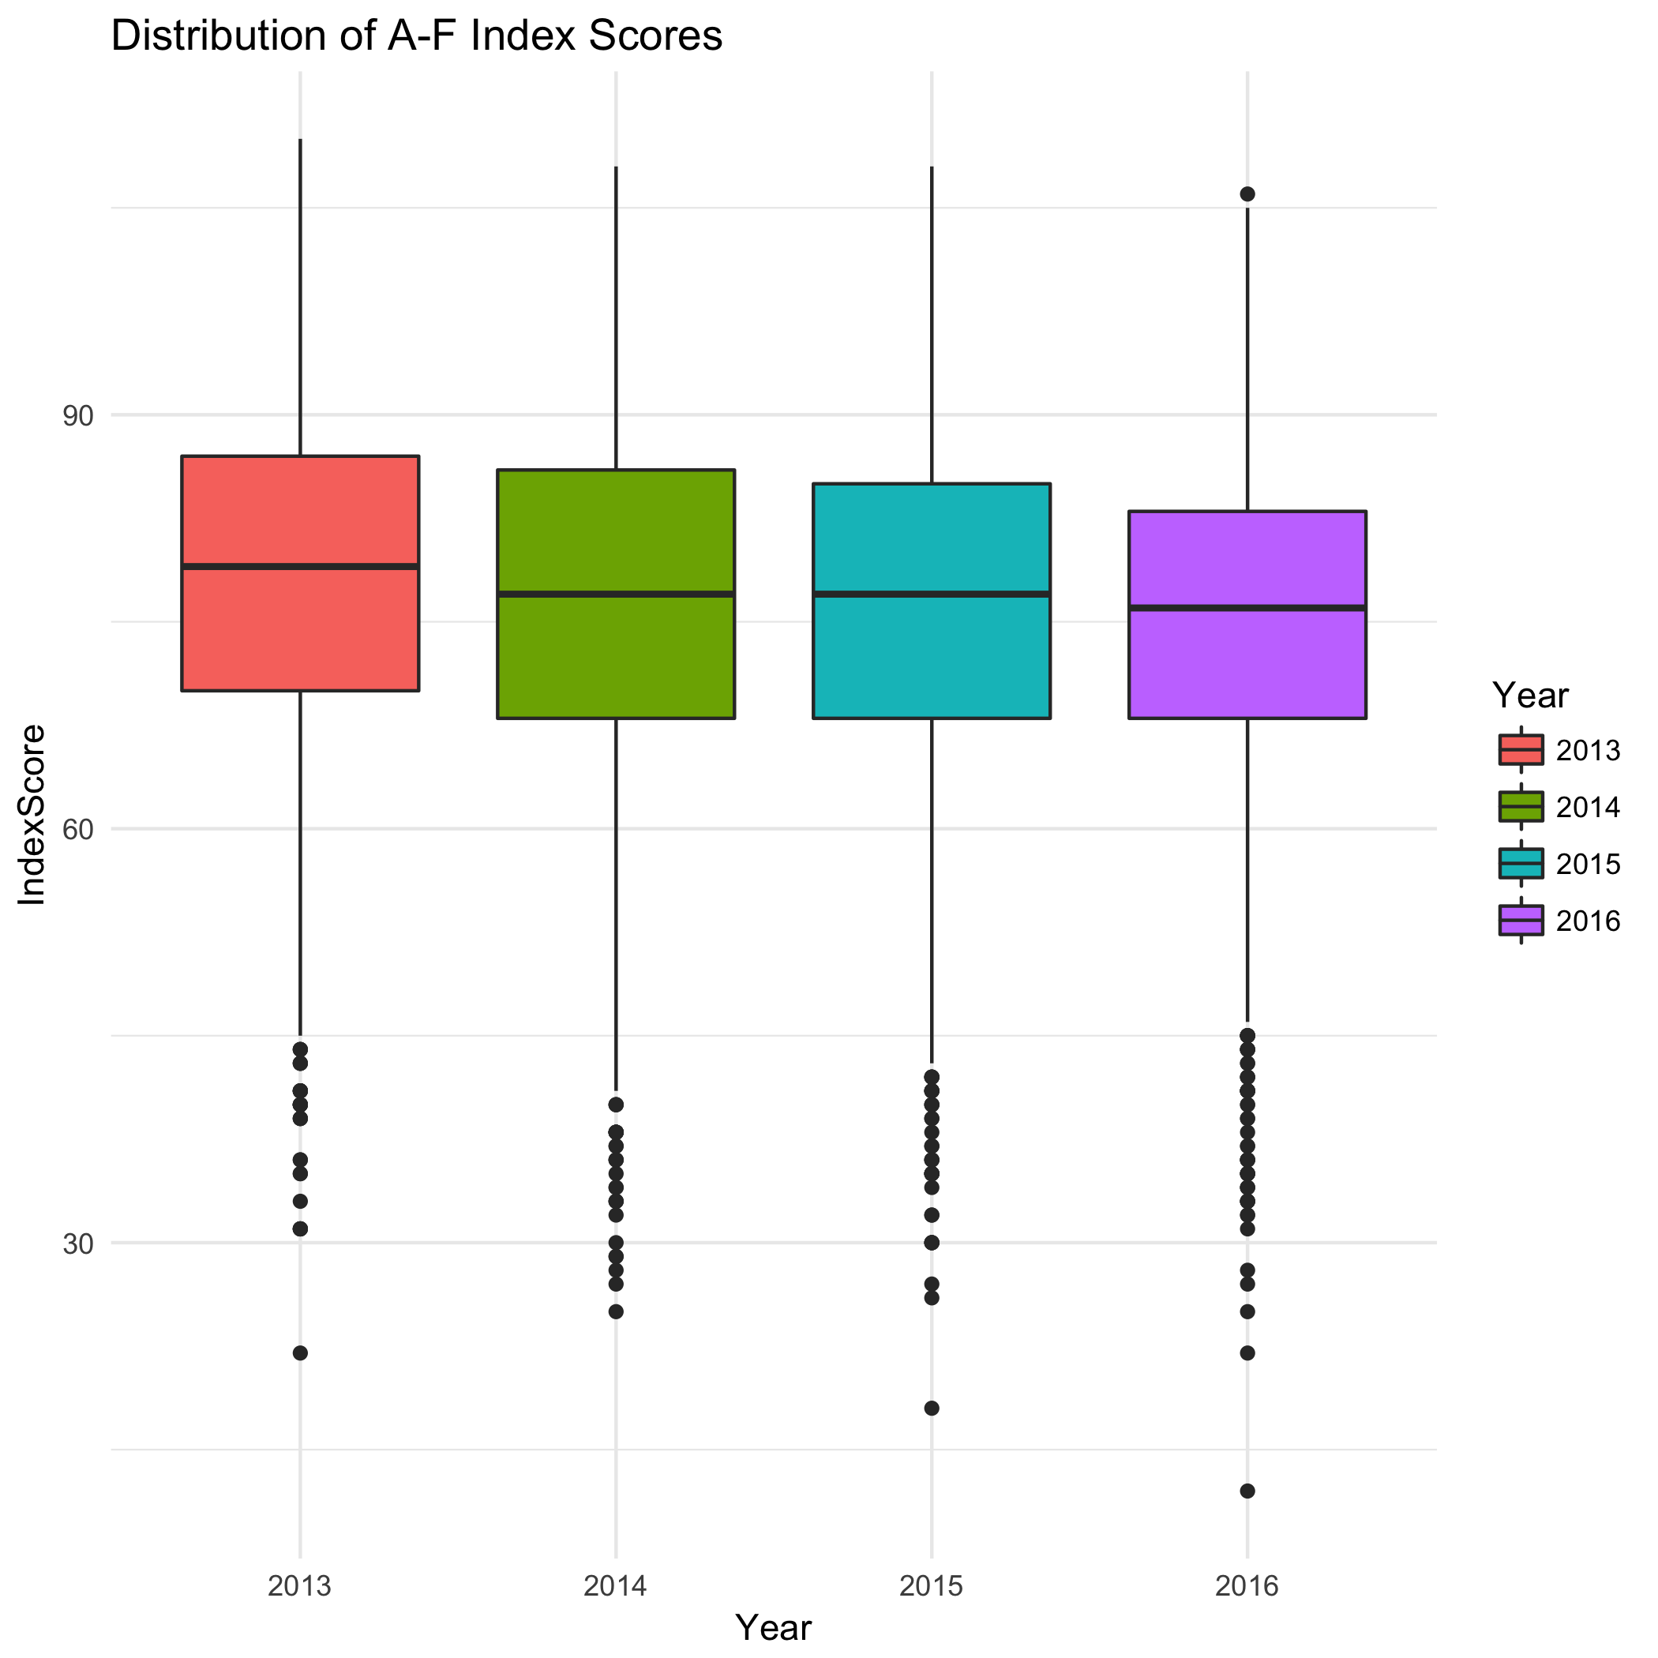
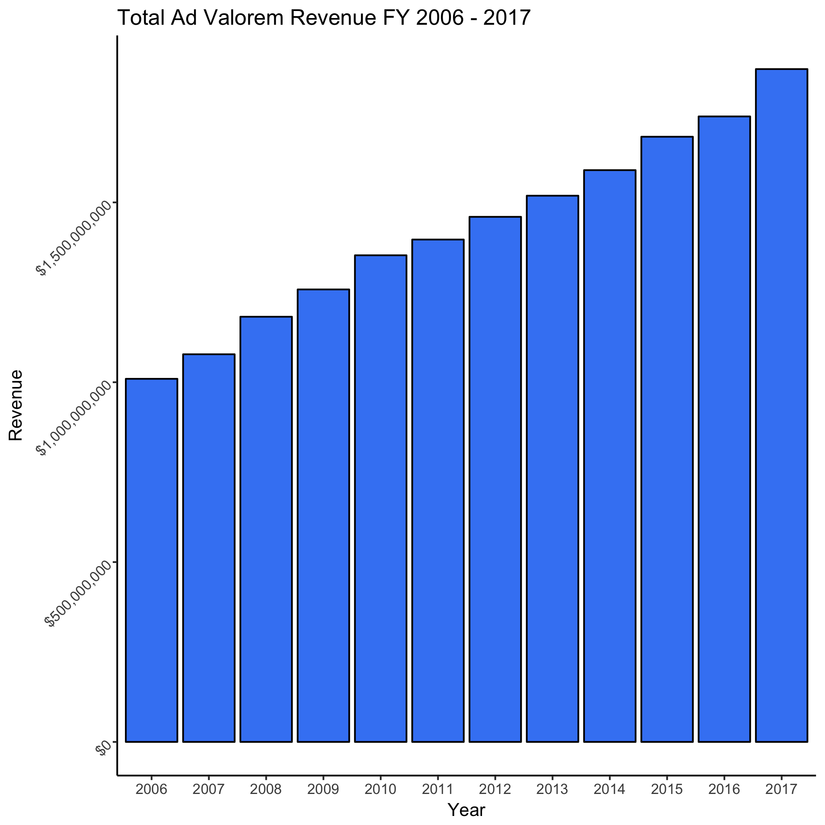
Source: OKSDE A-F Report Index
Source: OCAS District Revenue Summary Report

Slide 9
Theory & Methods:
Use three different methods to test model:
Linear Regression
Predict A-F Index Score using linear model
Principal Component Analysis (PCA)
Dimensionality Reduction combined with Regression methods
Artificial Neural Network
Capture hidden layers, non-linear relationships and interaction effects that illustrates the complexity that goes into measuring school quality.
Using these theories and methods I will evaluate the performance to see which one provides the most accurate prediction of school quality

Slide 10
Computational Tools:
MySQL
Use database hosted by the Oklahoma Public School Resource Center to aggregate and manage necessary data
Python
Data Cleaning and Management – SQLAlchemy, Pandas, Numpy
Multinomial Logistic Regression – Scikit learn LogisticRegression()
Principal Component Analysis – Scikit Learn Decomposition()
Artificial Neural Network – Tensor Flow, PyTorch

